Slide 1


Mathematics (9-1) - iGCSE
2018-20
Year 09
Unit 09 – Answers

Slide 2
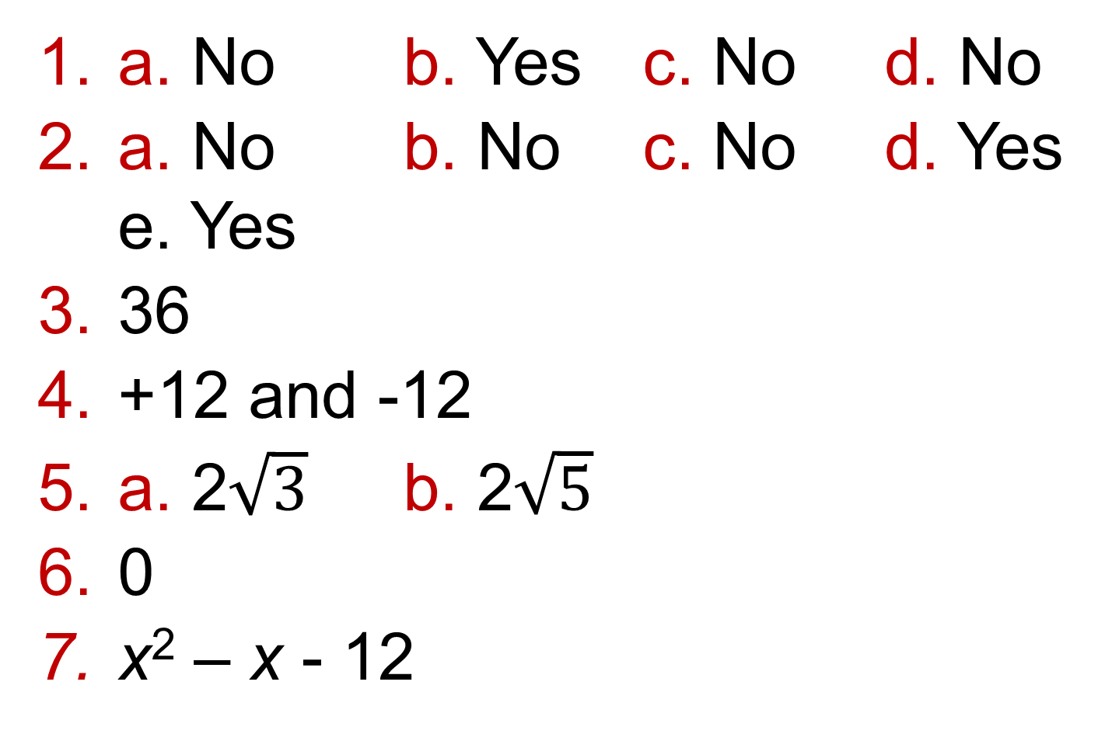
8 - Prior knowledge check
Page 662
a. No b. Yes c. No d. No
a. No b. No c. No d. Yes
e. Yes
36
+12 and -12
a. 2$\sqrt{3}$ b. 2$\sqrt{5}$
0
x² – x - 12

Slide 3
9 - Prior knowledge check
Page 662
a. x = 2 b. x = 5 c. x = -3
a. x(x + 8) b. (x + 3)(x + 1)
c. (y - 5)(y + 2)
d. (x + 5)(x - 5)
e. (2 + y) (2 - y)
2x + 3y - 53 = 0
x = - 1 or x = 4
-2 and -8

Slide 4
9.1 – Solving Quadratic Equations
Page 662
6 and -2 or -6 and 2
a. x(x - 5) b. (y - 2)(y + 2)
c. (x + 5)(x - 2)
a. z = ±6 b. z = ±4 c. z = ±5
a. x = ±4 b. x = ±7 c. x = ±5
a. x = 4 and x = 6
b. x = 5 and x = -6
c. y = -2 and y = -1
d. b = 2 and b = -5

Slide 5
9.1 – Solving Quadratic Equations
Page 662
a. x = 0 or x = 2 b. x = 4 or x = -4
c. y = -2 or y = 2
a. x = -3 or x = 2 b. (x + 3)(x - 2)
a. x = -1 and x = -6
b. x = -4 and x = 3
c. x = 2 and x = 4
d. x = 0 and x = 7
(x - 4)(x + 6) or any multiple
e.g. (2x - 8)(x + 6); (x - 4)(2x + 12)

Slide 6
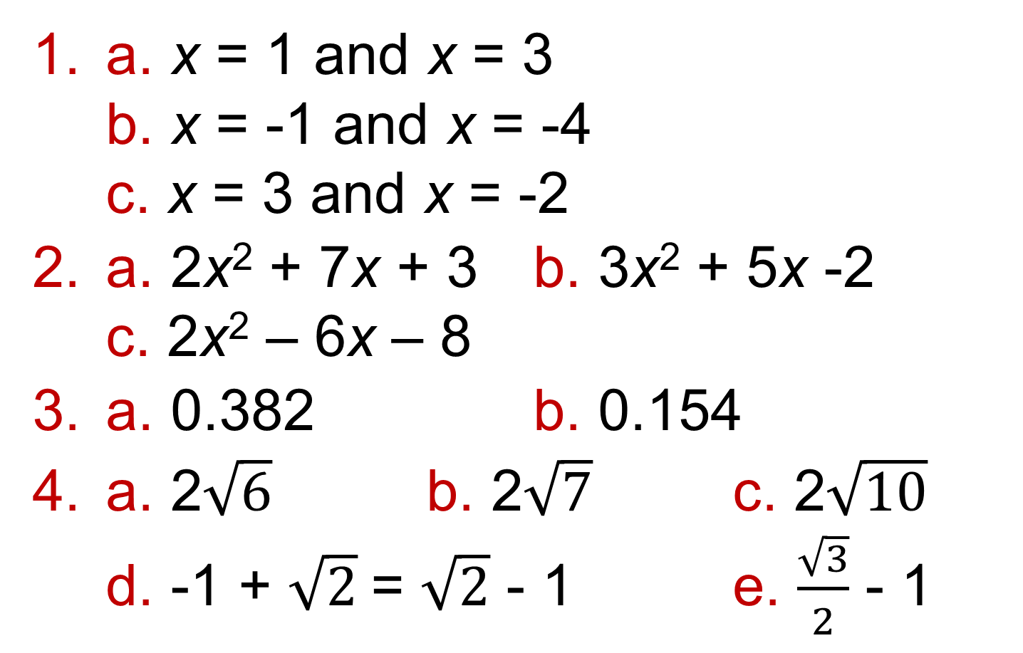
9.2 – Solving Quadratic Equations 2
Page 662
a. x = 1 and x = 3
b. x = -1 and x = -4
c. x = 3 and x = -2
a. 2x² + 7x + 3 b. 3x² + 5x -2
c. 2x² – 6x – 8
a. 0.382 b. 0.154
a. 2$\sqrt{6}$ b. 2$\sqrt{7}$ c. 2$\sqrt{10}$
d. -1 + $\sqrt{2}$= $\sqrt{2}$ - 1 e. $\frac{\sqrt{3}}{2}$ - 1

Slide 7
9.2 – Solving Quadratic Equations 2
Page 662
x(x + 1) = 30; x = 5m
2a(a + 1) = 12
2a² + 2a = 12
2a² + 2a - 12 = 0
(2a + 6)(a - 2) = 0
Therefore a = -3 or a = 2
Since a cannot be - 3, small rug is 2m x 2m.
(3x - 1)(x + 2)

Slide 8
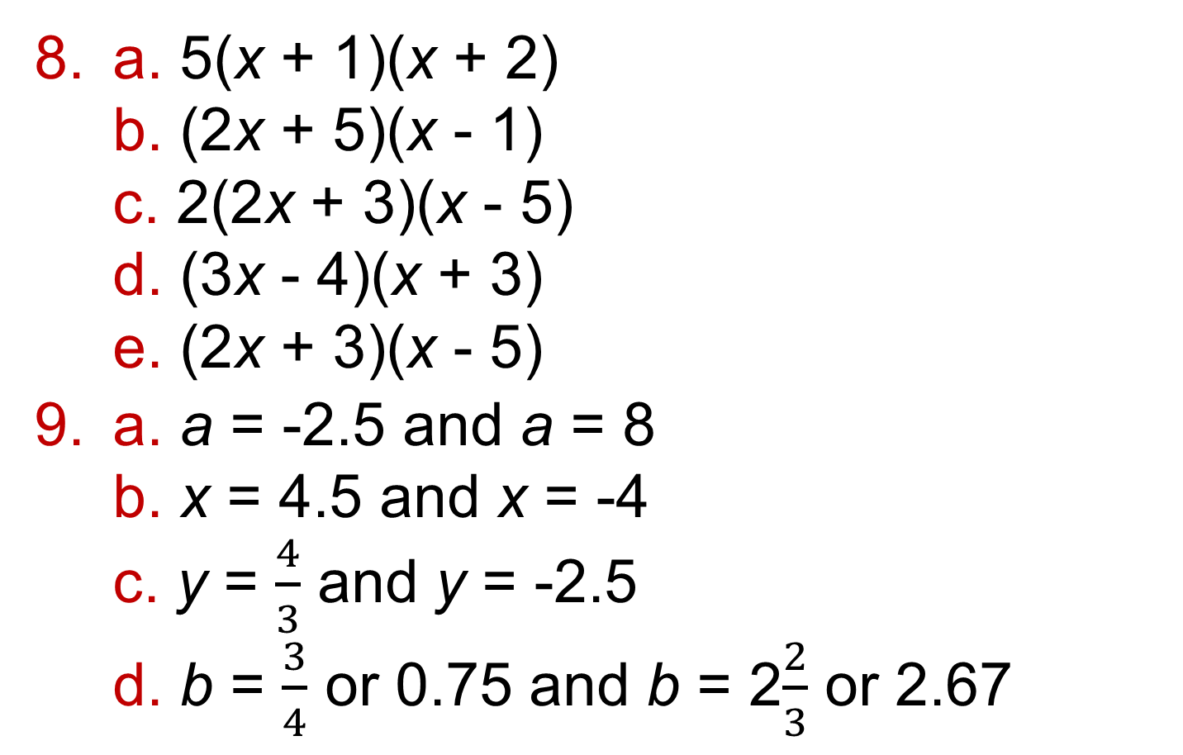
9.2 – Solving Quadratic Equations 2
Page 662
a. 5(x + 1)(x + 2)
b. (2x + 5)(x - 1)
c. 2(2x + 3)(x - 5)
d. (3x - 4)(x + 3)
e. (2x + 3)(x - 5)
a. a = -2.5 and a = 8
b. x = 4.5 and x = -4
c. y = $\frac{4}{3}$ and y = -2.5
d. b = $\frac{3}{4}$ or 0.75 and b = 2$\frac{2}{3}$ or 2.67

Slide 9
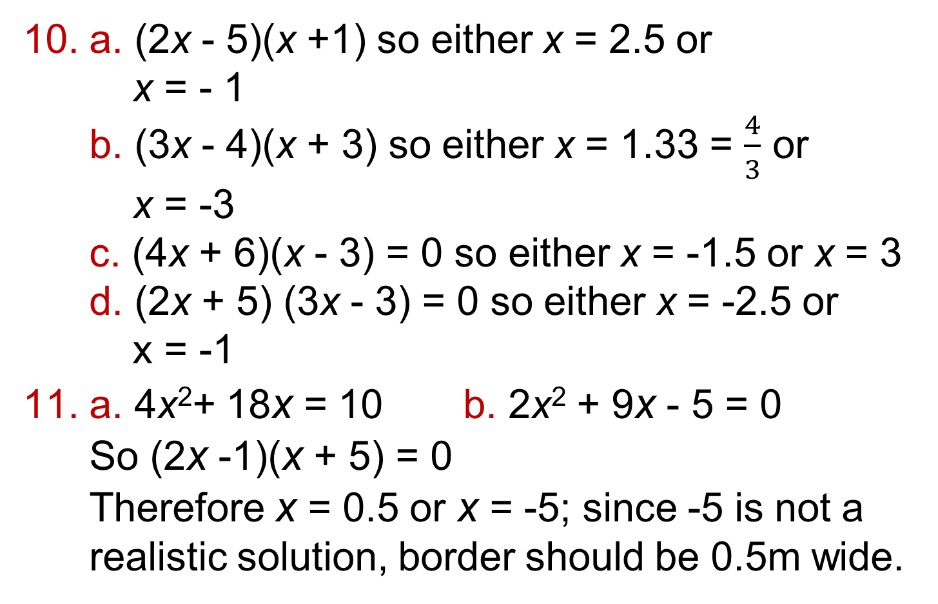
9.2 – Solving Quadratic Equations 2
Page 662
a. (2x - 5)(x +1) so either x = 2.5 or
x = - 1
b. (3x - 4)(x + 3) so either x = 1.33 = $\frac{4}{3}$ or
x = -3
c. (4x + 6)(x - 3) = 0 so either x = -1.5 or x = 3
d. (2x + 5) (3x - 3) = 0 so either x = -2.5 or
x = -1
a. 4x²+ 18x = 10 b. 2x² + 9x - 5 = 0
So (2x -1)(x + 5) = 0
Therefore x = 0.5 or x = -5; since -5 is not a realistic solution, border should be 0.5m wide.

Slide 10
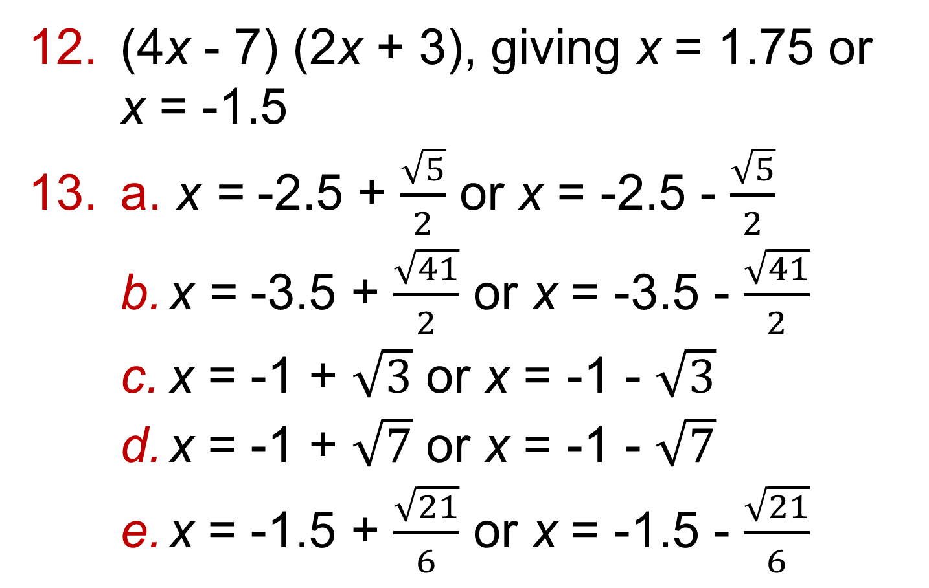
9.2 – Solving Quadratic Equations 2
Page 662
(4x - 7) (2x + 3), giving x = 1.75 or
x = -1.5
a. x = -2.5 + $\frac{\sqrt{5}}{2}$ or x = -2.5 - $\frac{\sqrt{5}}{2}$
  x = -3.5 + $\frac{\sqrt{41}}{2}$ or x = -3.5 - $\frac{\sqrt{41}}{2}$
  x = -1 + $\sqrt{3}$ or x = -1 - $\sqrt{3}$
  x = -1 + $\sqrt{7}$ or x = -1 - $\sqrt{7}$
  x = -1.5 + $\frac{\sqrt{21}}{6}$ or x = -1.5 - $\frac{\sqrt{21}}{6}$

Slide 11
9.2 – Solving Quadratic Equations 2
Page 662
a. x = 1.36 or x = -7.36
  x = 3.39 or x = -0.89
  x = 0.55 or x = -1.22
  x = 1.39 or x = -2.89
a, b x = -1.5 or x = 5
x = 0.27 or x = -1.47

Slide 12
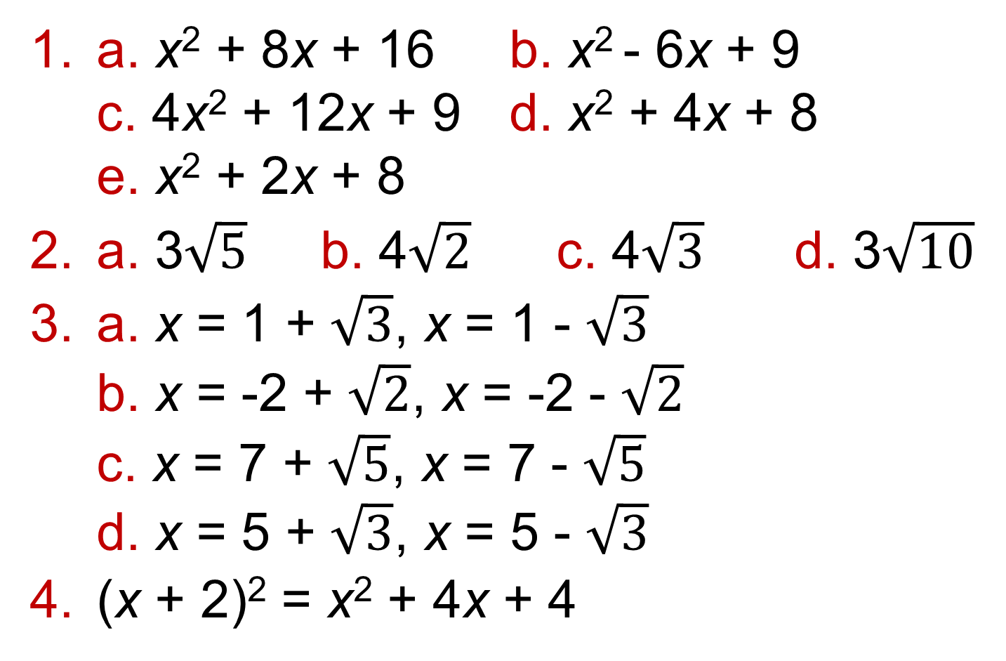
9.3 – Completing the Square
Page 662
a. x² + 8x + 16 b. x² - 6x + 9
c. 4x² + 12x + 9 d. x² + 4x + 8
e. x² + 2x + 8
a. 3$\sqrt{5}$ b. 4$\sqrt{2}$ c. 4$\sqrt{3}$ d. 3$\sqrt{10}$
a. x = 1 + $\sqrt{3}$, x = 1 - $\sqrt{3}$
b. x = -2 + $\sqrt{2}$, x = -2 - $\sqrt{2}$
c. x = 7 + $\sqrt{5}$, x = 7 - $\sqrt{5}$
d. x = 5 + $\sqrt{3}$, x = 5 - $\sqrt{3}$
(x + 2)² = x² + 4x + 4

Slide 13
9.3 – Completing the Square
Page 662
a. (x + 2)² + 1 b. (x + 2)² + 2
c. (x + 2)² – 5
a. (x + 3)² b. (x + 4)²
c. (x + 5)² d. (x + 6)²
a. (x + 1)² - 2 b. (x + 4)² - 16
c. (x + 6)² – 36 d. (x + 3)² + 2
e. (x - 2)² + 2

Slide 14
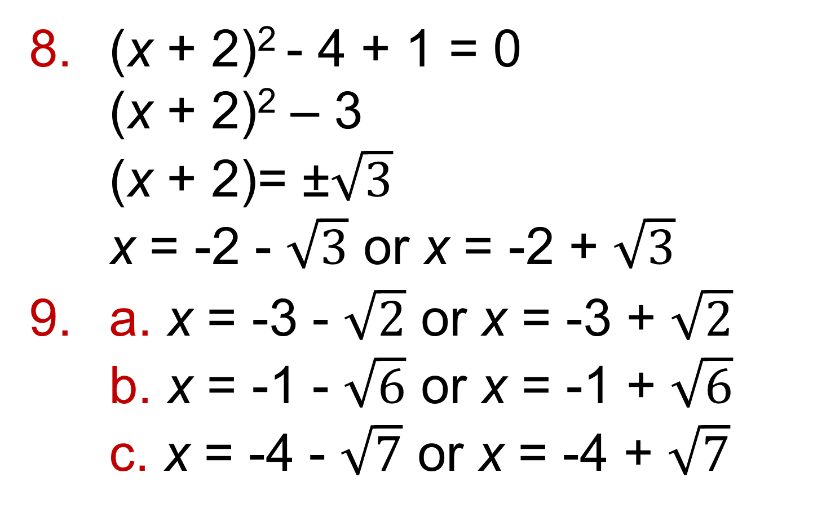
9.3 – Completing the Square
Page 663
(x + 2)² - 4 + 1 = 0
(x + 2)² – 3
(x + 2)= ±$\sqrt{3}$
x = -2 - $\sqrt{3}$ or x = -2 + $\sqrt{3}$
a. x = -3 - $\sqrt{2}$ or x = -3 + $\sqrt{2}$
b. x = -1 - $\sqrt{6}$ or x = -1 + $\sqrt{6}$
c. x = -4 - $\sqrt{7}$ or x = -4 + $\sqrt{7}$

Slide 15
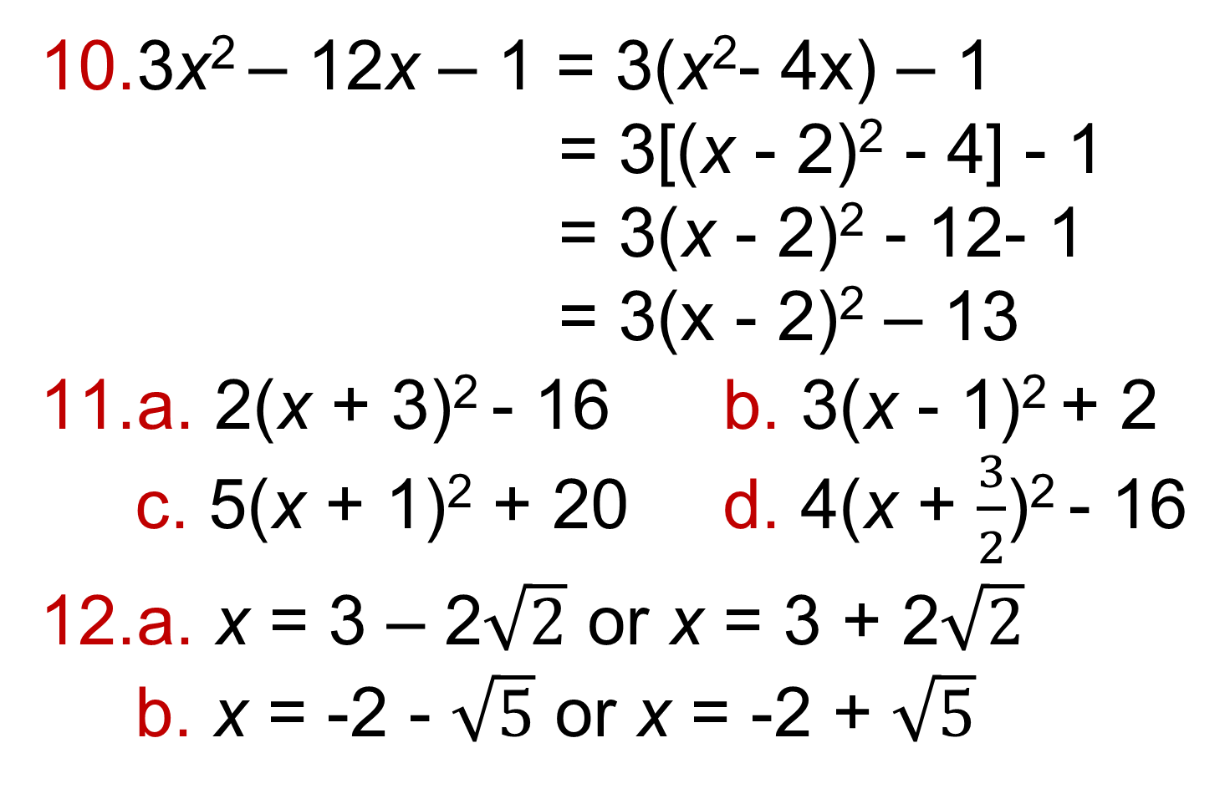
9.3 – Completing the Square
Page 663
3x² – 12x – 1 = 3(x²- 4x) – 1
= 3[(x - 2)² - 4] - 1
= 3(x - 2)² - 12- 1
= 3(x - 2)² – 13
a. 2(x + 3)² - 16 b. 3(x - 1)² + 2
c. 5(x + 1)² + 20 d. 4(x + $\frac{3}{2}$)² - 16
a. x = 3 – 2$\sqrt{2}$ or x = 3 + 2$\sqrt{2}$
b. x = -2 - $\sqrt{5}$ or x = -2 + $\sqrt{5}$

Slide 16
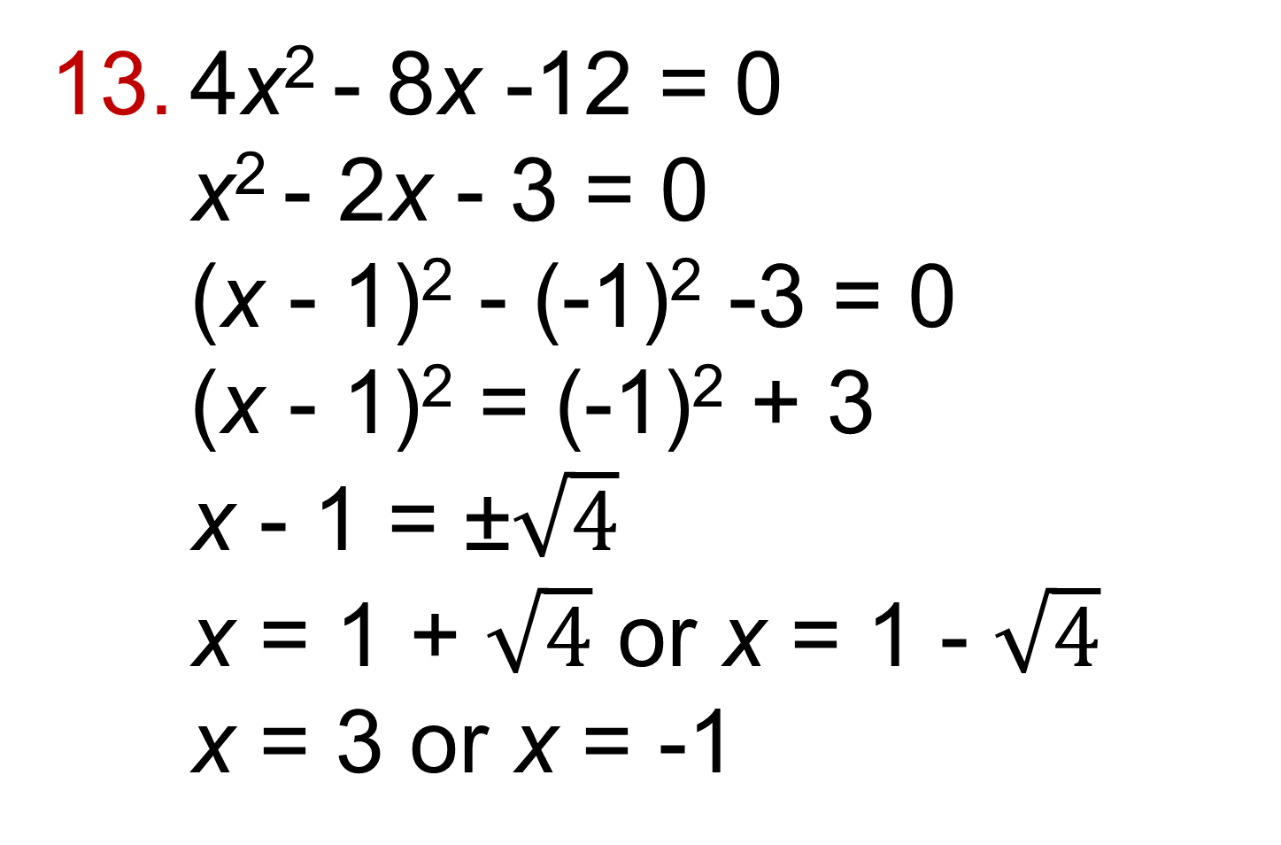
9.3 – Completing the Square
Page 663
4x² - 8x -12 = 0
x² - 2x - 3 = 0
(x - 1)² - (-1)² -3 = 0
(x - 1)² = (-1)² + 3
x - 1 = ±$\sqrt{4}$
x = 1 + $\sqrt{4}$ or x = 1 - $\sqrt{4}$
x = 3 or x = -1

Slide 17
9.3 – Completing the Square
Page 663
a. x = 1.24 or x = -3.24
b. x = 0.88 or x = -0.38
c. x = 1.08 or x = -3.08
d. x = 3.25 or x = -0.25
e. x = 0.60 or x = -2.10
x = 1.24 or x = -1.74

Slide 18
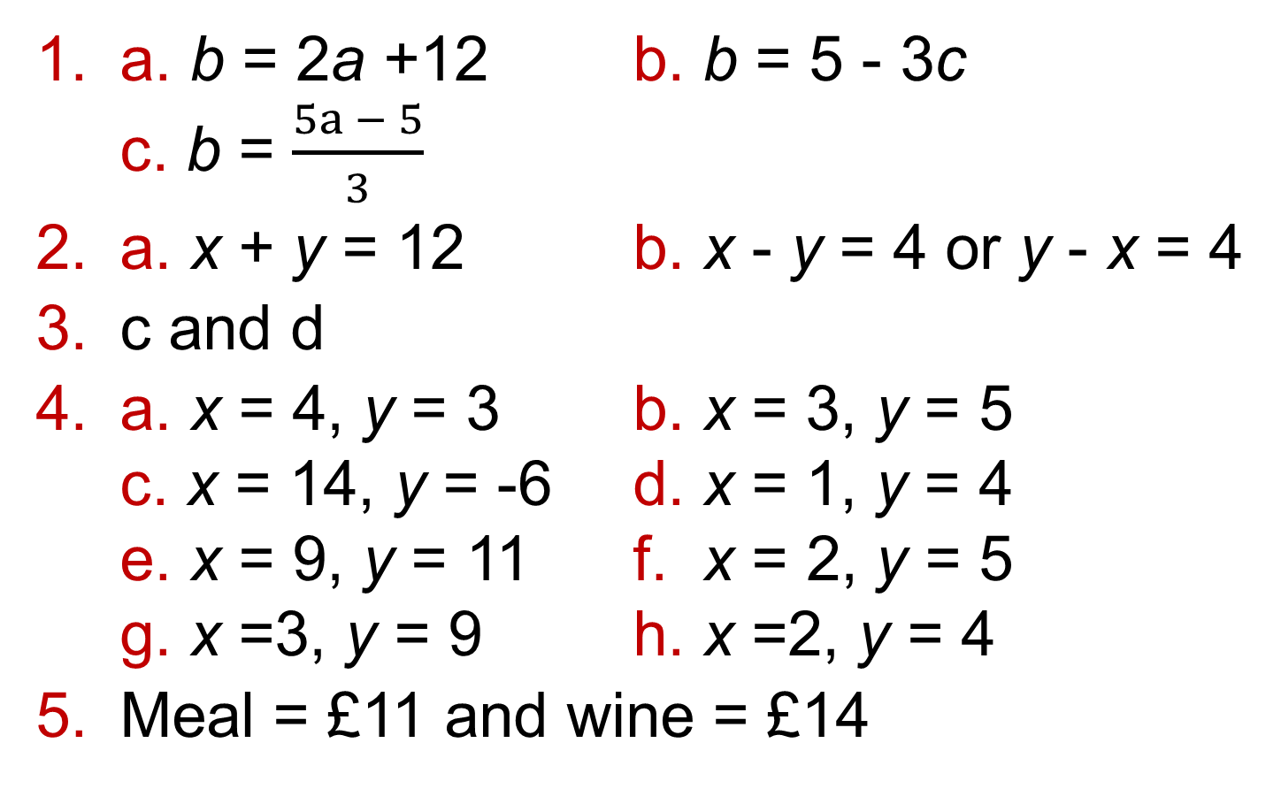
9.4 – Solving Simple Simultaneous Equations
Page 663
a. b = 2a +12 b. b = 5 - 3c
c. b = $\frac{5a − 5}{3}$
a. x + y = 12 b. x - y = 4 or y - x = 4
c and d
a. x = 4, y = 3 b. x = 3, y = 5
c. x = 14, y = -6 d. x = 1, y = 4
e. x = 9, y = 11 f. x = 2, y = 5
g. x =3, y = 9 h. x =2, y = 4
Meal = £11 and wine = £14

Slide 19
9.4 – Solving Simple Simultaneous Equations
Page 663
50p
a. x = 3, y = 2 b. x = 4, y = -5
c. x = 4, y = 2
Students' own answers. x = 3, y = 2
a. 6x + 2y = 34
b. 10x + 0 = 50, x = 5
c. y = 2
a. x = 2, y = 4 b. x = -2, y = 4
c. x = 3, y = 2 d. x = 8, y = 3

Slide 20
9.4 – Solving Simple Simultaneous Equations
Page 663
x = 2, y = -1
x = 0, y = 0
x + y = 23; x - y = 5; x = 14,
y = 9
a. £12 b. £24
x = 26 and y = 12.
Perimeter = 76 cm

Slide 21
9.5 – More Simultaneous Equations
Page 663
a. 8x + 12y = 24 b. 4x – 24y = 28
a. x = 2, y = 4 b. x = 4, y = 2
a. e.g. y = 2x + 1
b. e.g. y = 2x + 2
c. m = 3, c = -1 d. y = 3x - 1
y = 3 - x
a. x = 2, y = 1 b. x = 3, y = 2
c. x = -5, y = 3 d. x = 2, y = 4
e. x = 4, y = -6

Slide 22
9.5 – More Simultaneous Equations
Page 663
Coffee = 200p (£2) and scone = 90p
Adult = £1.80 and child = £1.00
Pear = 25p and banana = 60p
x = 0.67, y = -1.5
Sand = 20 kg and cement = 40 kg
x = £15 and y = £0.50 = 50 p. So a 50-mile hire would be £15 + 50 x £0.50= £40
a. 4a – 4b = -2 and 2a + b = 8
b. a = 2.5, b = 3
c. Rectangle is 6m by 10 m

Slide 23
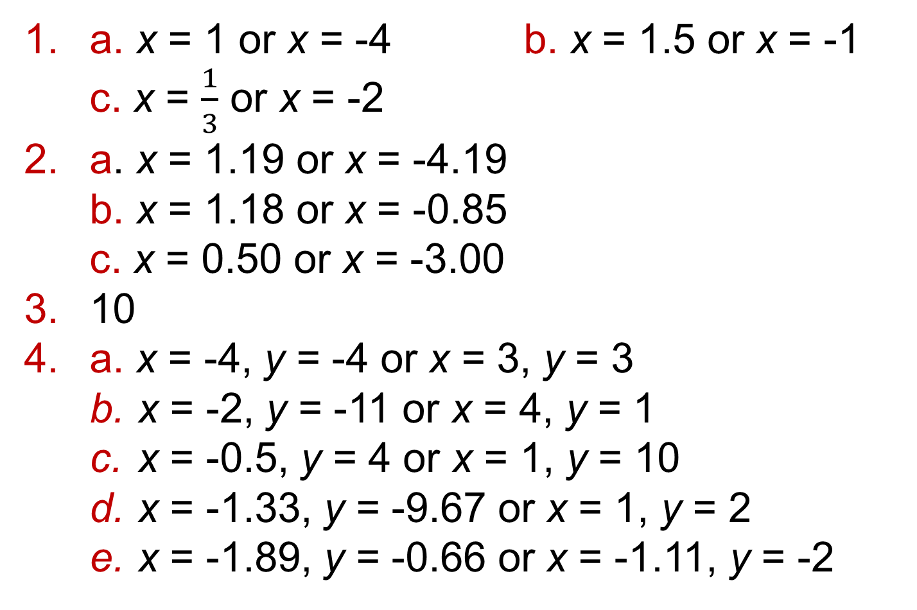
9.6 – Solving Simultaneous Linear & Quadratic Equations
Page 663
a. x = 1 or x = -4 b. x = 1.5 or x = -1
c. x = $\frac{1}{3}$ or x = -2
a. x = 1.19 or x = -4.19
b. x = 1.18 or x = -0.85
c. x = 0.50 or x = -3.00
10
a. x = -4, y = -4 or x = 3, y = 3
  x = -2, y = -11 or x = 4, y = 1
  x = -0.5, y = 4 or x = 1, y = 10
  x = -1.33, y = -9.67 or x = 1, y = 2
  x = -1.89, y = -0.66 or x = -1.11, y = -2

Slide 24
9.6 – Solving Simultaneous Linear & Quadratic Equations
Page 663
a. x = 0.70, y = 5.90 or x = -5.70, y = 25.10
b. x = 3.37, y = 9.74 or x = -2.37, y = -1.74
Points are (1, 0) and (-1, 8)
a. x = 1, y = 1 or x = -2, y = 4
b. x =1.41, y = 0.59 or x = -1.41, y = 3.41
c. x = -5, y = 0 or x = 0, y = 5
d. x = 1.82, y = 0.63 or x = 0.18, y = -2.63
e. x = -1, y = -3 or x = -3, y = 5
f. x = -3, y = 1 or x = 9, y = 5

Slide 25
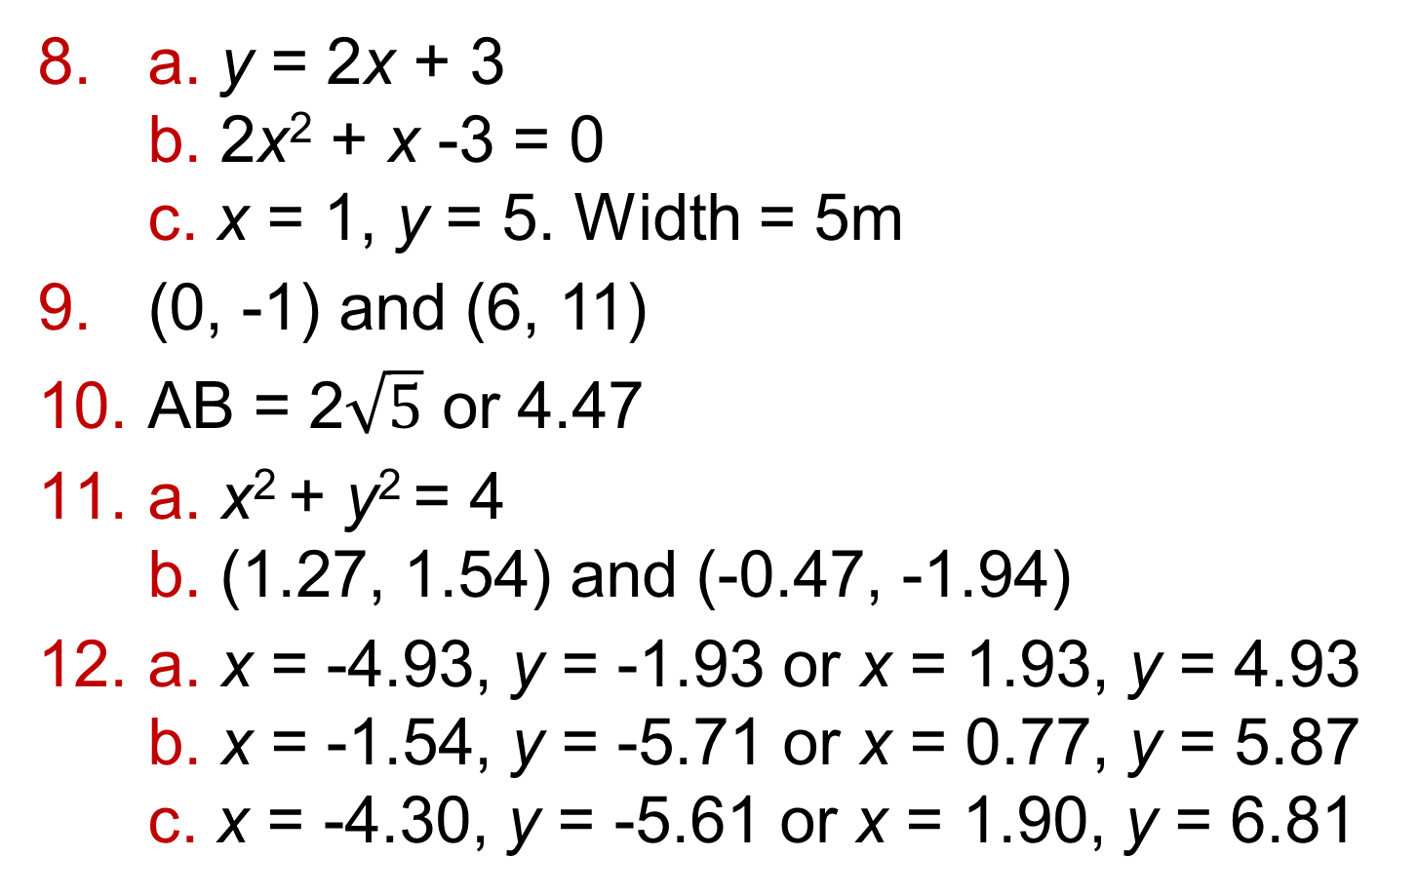
9.6 – Solving Simultaneous Linear & Quadratic Equations
Page 663
a. y = 2x + 3
b. 2x² + x -3 = 0
c. x = 1, y = 5. Width = 5m
(0, -1) and (6, 11)
AB = 2$\sqrt{5}$ or 4.47
a. x² + y² = 4
b. (1.27, 1.54) and (-0.47, -1.94)
a. x = -4.93, y = -1.93 or x = 1.93, y = 4.93
b. x = -1.54, y = -5.71 or x = 0.77, y = 5.87
c. x = -4.30, y = -5.61 or x = 1.90, y = 6.81

Slide 26
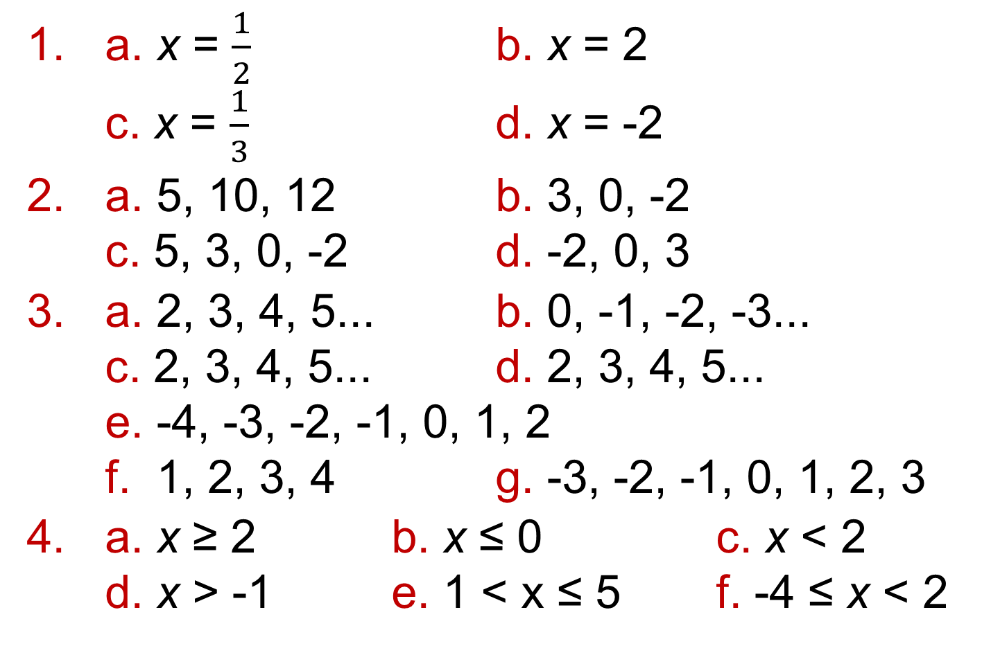
9.7 – Solving Linear Inequalities
Page 663
a. x = $\frac{1}{2}$ b. x = 2
c. x = $\frac{1}{3}$ d. x = -2
a. 5, 10, 12 b. 3, 0, -2
c. 5, 3, 0, -2 d. -2, 0, 3
a. 2, 3, 4, 5... b. 0, -1, -2, -3...
c. 2, 3, 4, 5... d. 2, 3, 4, 5...
e. -4, -3, -2, -1, 0, 1, 2
f. 1, 2, 3, 4 g. -3, -2, -1, 0, 1, 2, 3
a. x ≥ 2 b. x ≤ 0 c. x < 2
d. x > -1 e. 1 < x ≤ 5 f. -4 ≤ x < 2

Slide 27
9.7 – Solving Linear Inequalities
Page 663
a. -3, -2, 01, 0, 1 b. -2 ≤ x ≤ 4
a.
b.
c.
d.
X
-5 -4 -3 -2 -1 0 1 2 3 4 5
X
-5 -4 -3 -2 -1 0 1 2 3 4 5
X
-5 -4 -3 -2 -1 0 1 2 3 4 5
X
-5 -4 -3 -2 -1 0 1 2 3 4 5

Slide 28
9.7 – Solving Linear Inequalities
Page 663
a. The set of all x values such that x is less than 2
  The set of all x values such that x is less than or equal to-2
  The set of all x values such that x is greater than or equal to 0
  The set of all x values such that x is less than or equal to 0
  The set of all x values such that x is greater than -1

Slide 29
9.7 – Solving Linear Inequalities
Page 664
a.
b.
c.
d.
e.
X
-5 -4 -3 -2 -1 0 1 2 3 4 5
X
-5 -4 -3 -2 -1 0 1 2 3 4 5
X
-5 -4 -3 -2 -1 0 1 2 3 4 5
X
-5 -4 -3 -2 -1 0 1 2 3 4 5
X
-5 -4 -3 -2 -1 0 1 2 3 4 5

Slide 30
9.7 – Solving Linear Inequalities
Page 664
a. {x:x > 3} b. {x:x > -3}
c. {x:x > 3} d. {x:x ≤ 2}
The Smallest value of x is 4
a. {x:x > 4} b. {x:x > -3}
c. {x:x > -5.5} d. {x:x > 1.8}
a. -4 < x ≤ 2 b. -3 < x ≤ 4
c. -3 ≤ x ≤ 9 d. -1 < x ≤ 3

Slide 31
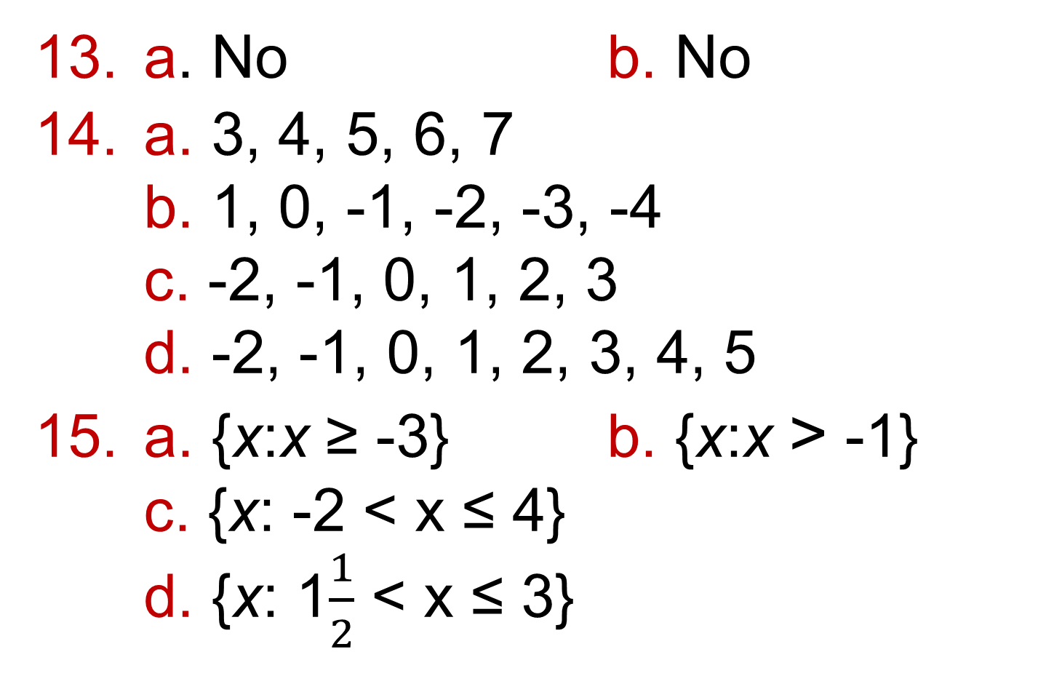
9.7 – Solving Linear Inequalities
Page 664
a. No b. No
a. 3, 4, 5, 6, 7
b. 1, 0, -1, -2, -3, -4
c. -2, -1, 0, 1, 2, 3
d. -2, -1, 0, 1, 2, 3, 4, 5
a. {x:x ≥ -3} b. {x:x > -1}
c. {x: -2 < x ≤ 4}
d. {x: 1$\frac{1}{2}$ < x ≤ 3}

Slide 32
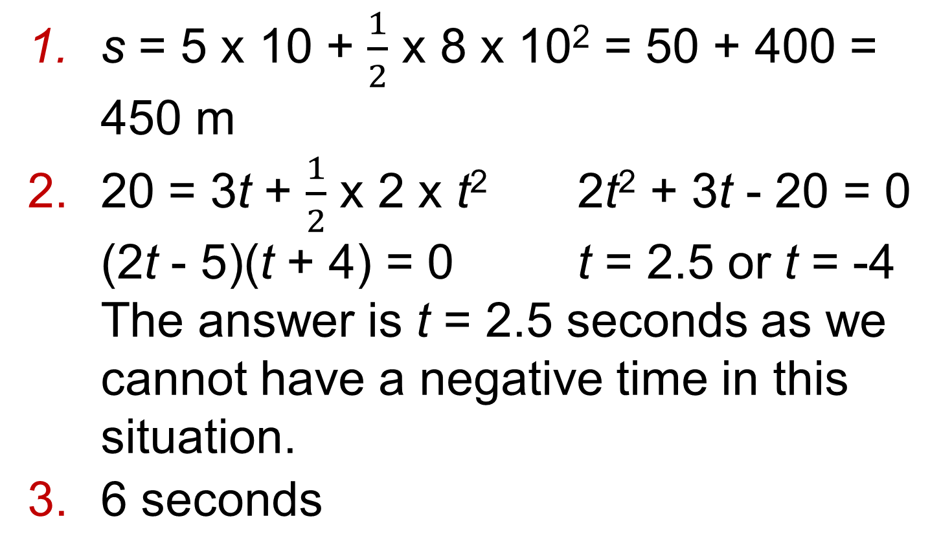
9 – Problem Solving
Page 664
s = 5 x 10 + $\frac{1}{2}$ x 8 x 10² = 50 + 400 = 450 m
20 = 3t + $\frac{1}{2}$ x 2 x t² 2t² + 3t - 20 = 0
(2t - 5)(t + 4) = 0 t = 2.5 or t = -4
The answer is t = 2.5 seconds as we cannot have a negative time in this situation.
6 seconds

Slide 33
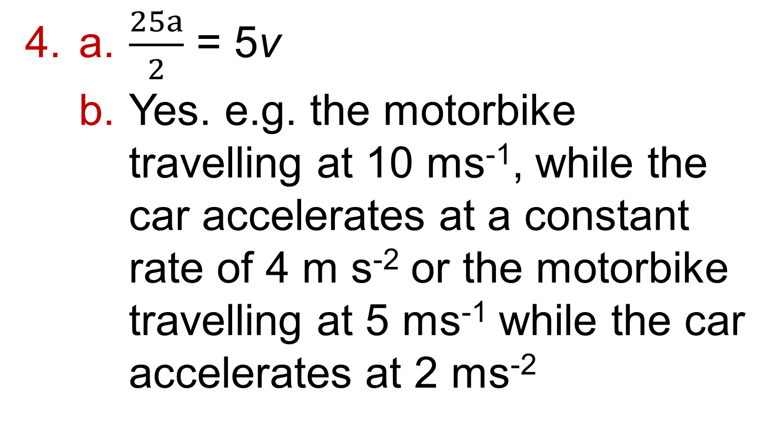
9 – Problem Solving
Page 664
a. $\frac{25a}{2}$ = 5v
  Yes. e.g. the motorbike travelling at 10 ms⁻¹, while the car accelerates at a constant rate of 4 m s⁻² or the motorbike travelling at 5 ms⁻¹ while the car accelerates at 2 ms⁻²

Slide 34
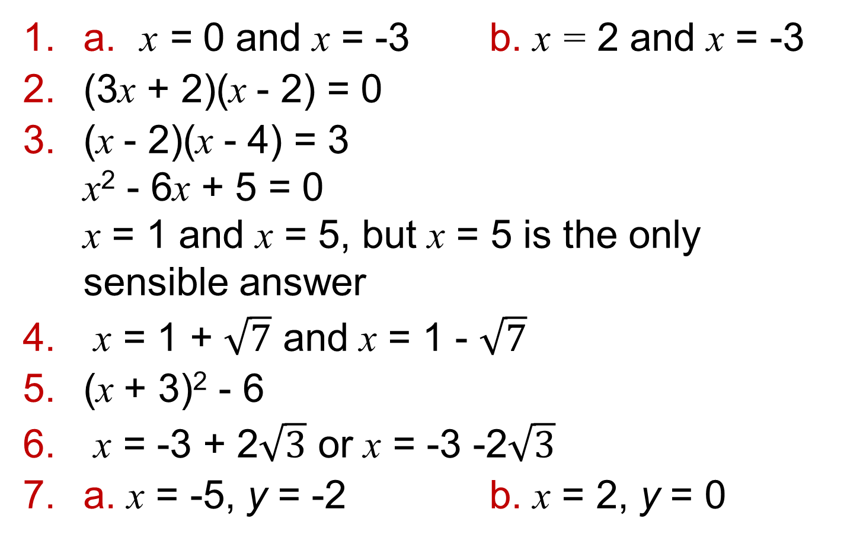
9 – Check-Up
Page 664
a. x = 0 and x = -3 b. x = 2 and x = -3
(3x + 2)(x - 2) = 0
(x - 2)(x - 4) = 3
x² - 6x + 5 = 0
x = 1 and x = 5, but x = 5 is the only sensible answer
x = 1 + $\sqrt{7}$ and x = 1 - $\sqrt{7}$
(x + 3)² - 6
x = -3 + 2$\sqrt{3}$ or x = -3 -2$\sqrt{3}$
a. x = -5, y = -2 b. x = 2, y = 0

Slide 35
9 – Check-Up
Page 664
y = 2x - 3
x = -5, y = 15 or x = 1, y = 3
1, 0, -1, -2, -3, -4 and -5
a. 0 < x ≤ 9
b.
a. 6 years old
b. Students' own answers
X
0 1 2 3 4 5 6 7 7 9 10

Slide 36
9 – Strengthen
Page 664
Quadratic equations
x = 0, x = -7
a. x(x + 5) b. x = 0, x = -5
a. -4 and 3 b. (x + 3)(x - 4)
c. x = -3, x = 4
a. x = -6, x = 3 b. x = 4, x = 3
c. x = -5, x = 3
a. -1, 6; 1, -6; -2, 3; 2, -3
b. (2x -3)(x + 2)
c. x = -1.5 or x = -2

Slide 37
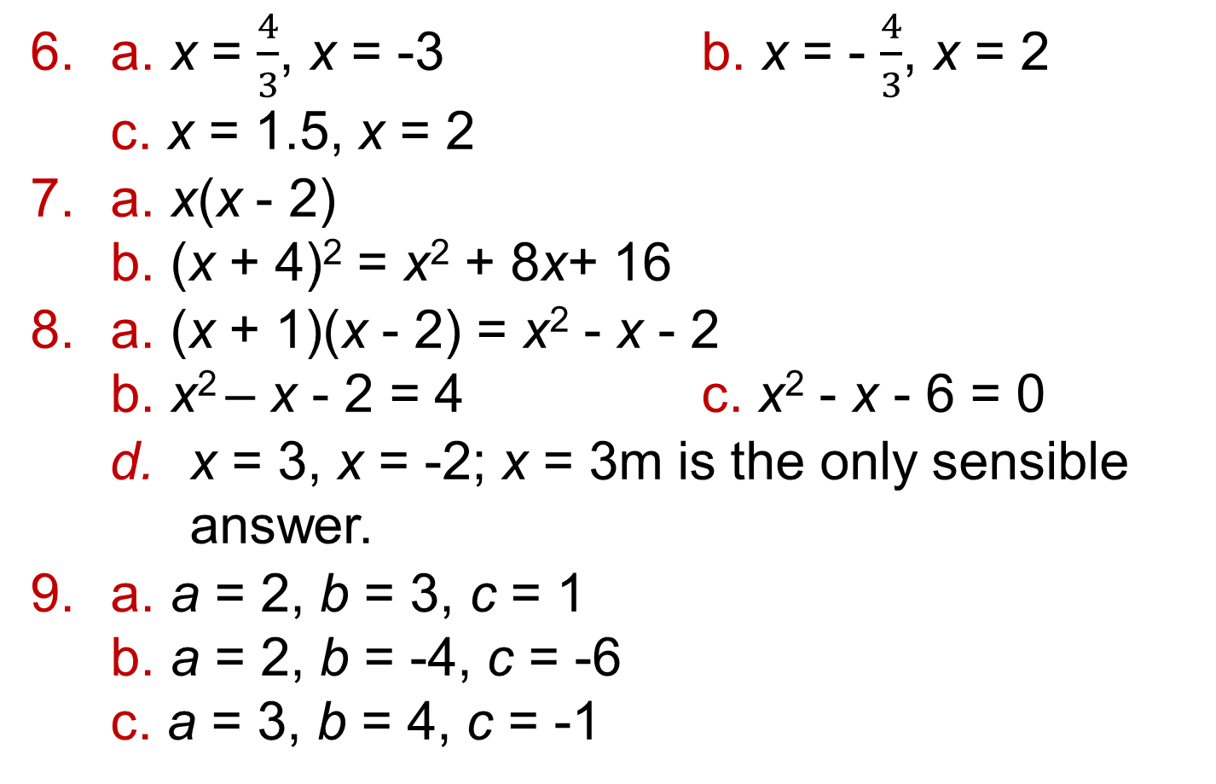
9 – Strengthen
Page 664
a. x = $\frac{4}{3}$, x = -3 b. x = - $\frac{4}{3}$, x = 2
c. x = 1.5, x = 2
a. x(x - 2)
b. (x + 4)² = x² + 8x+ 16
a. (x + 1)(x - 2) = x² - x - 2
b. x² – x - 2 = 4 c. x² - x - 6 = 0
  x = 3, x = -2; x = 3m is the only sensible answer.
a. a = 2, b = 3, c = 1
b. a = 2, b = -4, c = -6
c. a = 3, b = 4, c = -1

Slide 38
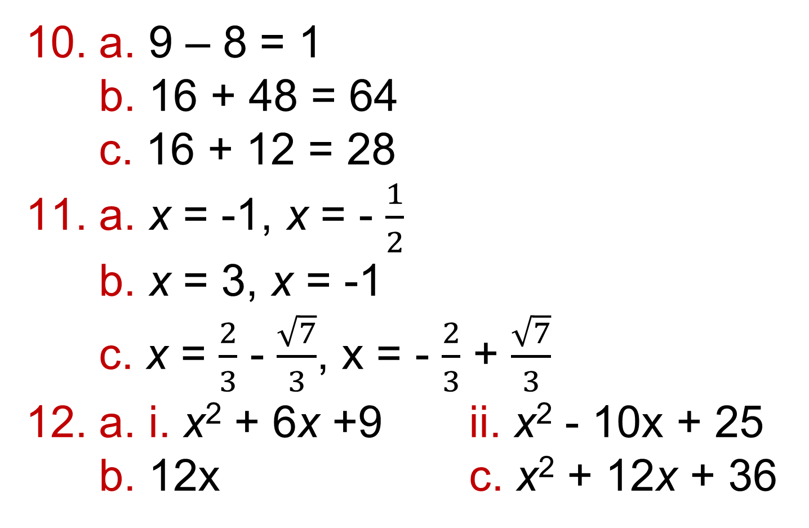
9 – Strengthen
Page 664
a. 9 – 8 = 1
b. 16 + 48 = 64
c. 16 + 12 = 28
a. x = -1, x = - $\frac{1}{2}$
b. x = 3, x = -1
c. x = $\frac{2}{3}$ - $\frac{\sqrt{7}}{3}$, x = - $\frac{2}{3}$ + $\frac{\sqrt{7}}{3}$
a. i. x² + 6x +9 ii. x² - 10x + 25
b. 12x c. x² + 12x + 36

Slide 39
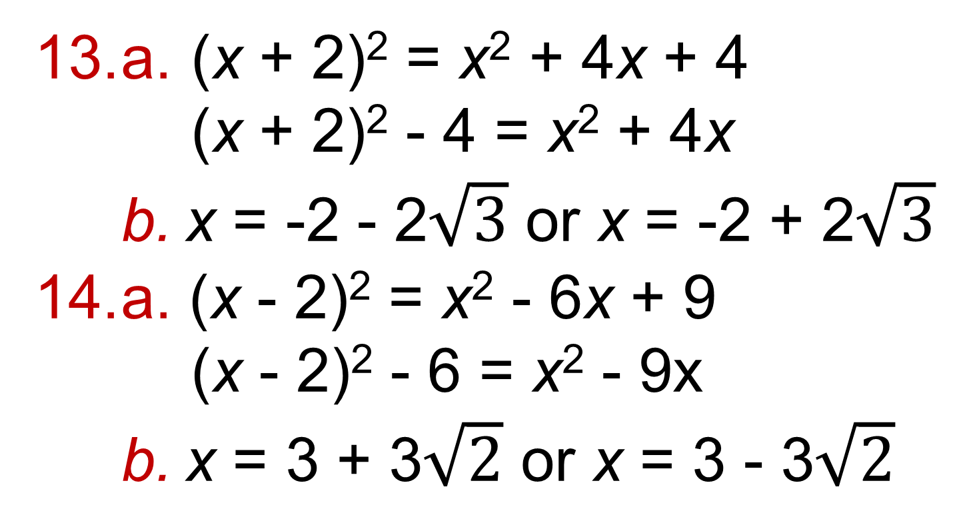
9 – Strengthen
Page 664
a. (x + 2)² = x² + 4x + 4
(x + 2)² - 4 = x² + 4x
  x = -2 - 2$\sqrt{3}$ or x = -2 + 2$\sqrt{3}$
a. (x - 2)² = x² - 6x + 9
(x - 2)² - 6 = x² - 9x
  x = 3 + 3$\sqrt{2}$ or x = 3 - 3$\sqrt{2}$

Slide 40
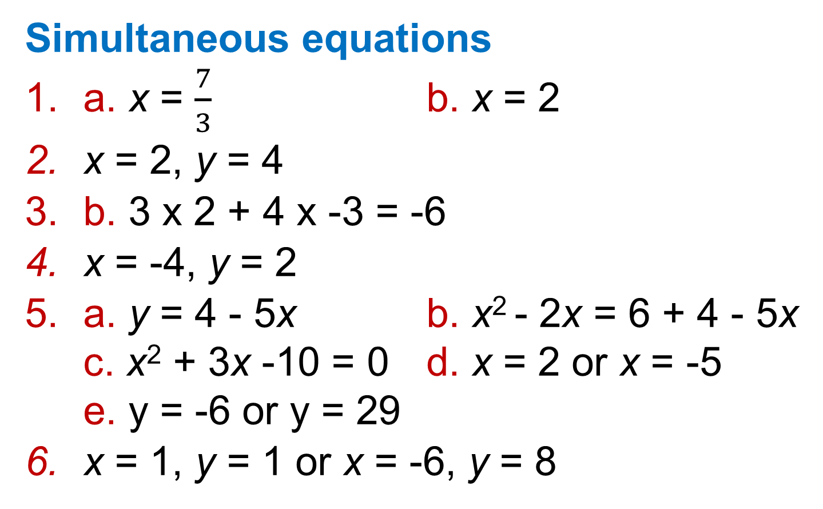
9 – Strengthen
Page 664
Simultaneous equations
a. x = $\frac{7}{3}$ b. x = 2
x = 2, y = 4
b. 3 x 2 + 4 x -3 = -6
x = -4, y = 2
a. y = 4 - 5x b. x² - 2x = 6 + 4 - 5x
c. x² + 3x -10 = 0 d. x = 2 or x = -5
e. y = -6 or y = 29
x = 1, y = 1 or x = -6, y = 8

Slide 41
9 – Strengthen
Page 664
Inequalities
a. -2 ≤ x ≤ 1 b. 4 < y < 10 c. 3 ≤ z < 8
a. i.
ii.
iii.
  i. e.g. 4, 5 ii. e.g. 6, 5 iii. e.g. 4, 5, 6
0 1 2 3 4 5 6
X
X
4 5 6 7 8
X
3 4 5 6 7

Slide 42
9 – Strengthen
Page 664
a.
  Values for c are -1, 0, 1, 2, 3, 4 Values for d are -4, -3, -2, -1,0,1,2,3, 4
0 1 2 3 4
X
-2 -1 0 1 2 3
X
-2 -1 0 1 2 3 4
X
-4 -3 -2 -1 0 1 2 3 4
X

Slide 43
9 – Strengthen
Page 664
a. x > 8
  x > 3
    -3 < x < 4
    4 ≤ x ≤ 12
a. x > 1 b. x < 4
c. 2, 3
0, 1, 2

Slide 44
9 – Strengthen
Page 665
Q5
Q5
Q5
Q6
-5 -4 -3 -2 -1 0 1 2 3 4 5
X
-5 -4 -3 -2 -1 0 1 2 3 4 5
X
-5 -4 -3 -2 -1 0 1 2 3 4 5
X
-5 -4 -3 -2 -1 0 1 2 3 4 5
X

Slide 45
9 – Strengthen
Page 665
a. {x:x > 4}
  {x:x < 7}
  {x:x ≥ 5}
  {x:0 ≤ x < 3}

Slide 46
9 – Strengthen
Page 665
a. x(x + 1) = 30 b. 5 and 6
23.32 m
3(x + 0.4)² – 0.48
a = 3, p = 0.4, q = -0.48
68m x 125m
a. Area = x(x + 4) + x(x +1) = x² + 4x + x² + x
2x² + 5x = 75
So 2x²+ 5x - 75 = 0
b. x = 5 or x = -7.5

Slide 47
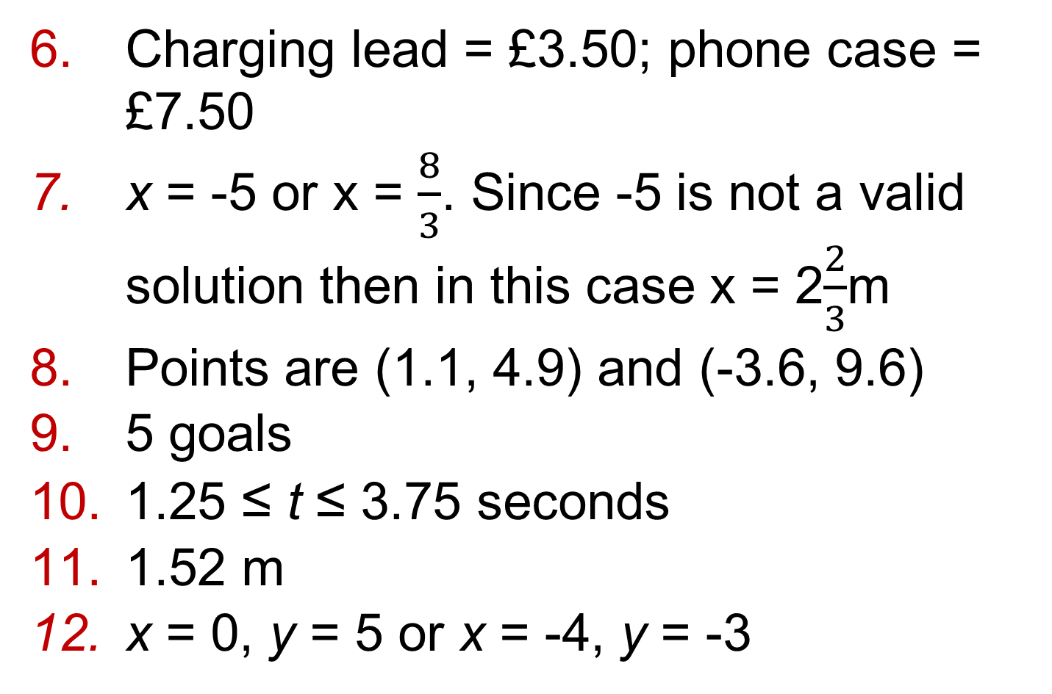
9 – Strengthen
Page 665
Charging lead = £3.50; phone case = £7.50
x = -5 or x = $\frac{8}{3}$. Since -5 is not a valid solution then in this case x = 2$\frac{2}{3}$m
Points are (1.1, 4.9) and (-3.6, 9.6)
5 goals
1.25 ≤ t ≤ 3.75 seconds
1.52 m
x = 0, y = 5 or x = -4, y = -3

Slide 48
9 – Strengthen
Page 665
a. (x + p)² + q = (x + p)(x + p) + q = x² + 2px + p² + 7
  i. (x + 3)² + 6
  ii. (x + 4)² -19
  iii. (x - 2)² - 2
-5 -4 -3 -2 -1 0 1 2 3 4 5
X

Slide 49
9 – Unit Test
Page 665
Sample student answer
There could end up being 3 or 4 different equations, so it is a good idea to label them to avoid confusion.
The letters s and l could look like a 5 or 1, which might lead to a mistake.
The student needs to make it clear how many paper clips are in each box, with a statement like, 'There are 60 paper clips in the small box and 175 paper clips in the large box'.

Slide 50











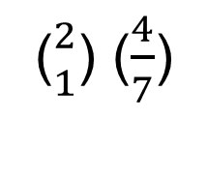






Warm Up
∪ ∩
Reflect
14 – Exam-Style Questions
∞ ∝
Sophie is making Christmas cards. She needs a card and an envelope for each card.
How many packs of cards and envelopes did she buy? (3 marks)
$$\frac{1}{2}$$
$$\frac{□}{□}$$
$\overline{x}$. $\overline{y}$
(${2 \atop 1}$) ($\frac{4}{7}$)
≈ є ϵ $θ$ µ
∠ π $\vec{CD}$
$$\sqrt{16}$$
±
①
②
③
④
ActiveLearn - Homework, practice and support: Higher 3.1
$$\sqrt[1]{\begin{aligned}3 \\ 4\end{aligned}}$$
$$\sqrt[1]{67}$$
1̇
£
≠ ÷ ≡
Q3 hint - The symbol ± shows that.
4͘͘
Key Point 1
4
When there are m ways of doing one task and n
$$\sqrt{\frac{A}{\text{π}}}$$
Q5 communication hint - Inclusive means that the end numbers
Q9f strategy hint - The symbol
X
-5 -4 -3 -2 -1 0 1 2 3 4 5
Age, a (x) | Male | Female
20 ≥ x ≤ 25 | 1 | 0
Exam hint
Show a separate
squared
Number | 1 | 2 | 3 | 4 | 5
Frequency | 46 | 39 | 37 | 40 | 38
1 | 6 | 7 | 9 | 9
2 | 1 | 2 | 2 | 4 | 6 | 7 | 8
3 | 3 | 6 | 6 | 7 | 8 | 9 | 9
4 | 0 | 0 | 1 | 3 | 4 | 5 | 8 | 8 | 9 | 9
5 | 0 | 1 | 2 | 4 | 4 | 5 | 6 | 7 | 9

